Slide 1



COLUMBIA ASIA
HOSPITAL
-by Ankur Choudhary

Slide 2

About Columbia Asia Hospital
Columbia Asia Hospital is a leading healthcare provider known for its multispecialty services and patient-centric approach.
With an increasing patient base and growing operations, the hospital aims to enhance both financial performance and service quality through data-driven insights

Slide 3
Problem Statement
Columbia Asia Hospital aims to leverage data analytics to gain deeper insights into its operations and improve overall performance. The key focus areas include:
Revenue Analysis: Understanding how different departments contribute to the hospital’s total revenue.
Workforce Planning: Identifying departments that require additional staffing based on patient flow and service demand.
Discount Strategy: Developing effective discount policies to enhance patient satisfaction while maintaining profitability.

Slide 4
OBJECTIVES
Analyze hospital data to uncover key business insights
Provide data-backed recommendations to help management make informed, strategic decisions
Build visual dashboards that simplify complex information and support decision-making.

Slide 5

Methodology
1.Data Preparation
2. Patient & Department Analysis
3. Financial Insights
4. Recommendations

Slide 6
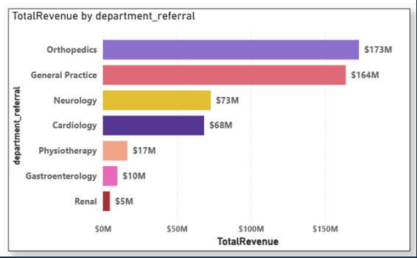
Department Wise Revenue
Key Insights:
Orthopedics and General Practice are the top revenue-generating departments, contributing the highest share to the hospital’s overall income indicating strong patient demand and service utilization in these areas.
Renal and Gastroenterology generate the least revenue, suggesting either lower patient inflow or limited service offerings, which may require further review or targeted improvement strategies.

Slide 7
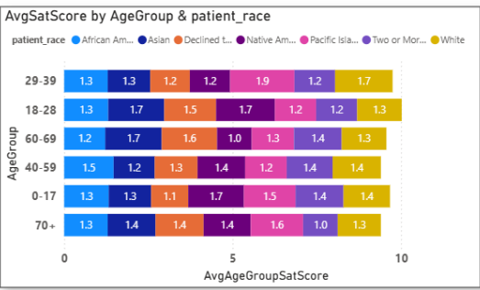
Patient Satisfaction Analysis by Age & Race
Key Insights:
The numbers look a little low, right? That’s because during data cleaning, it was found that around 72% of patient satisfaction scores were missing possibly due to incomplete survey submissions, unrecorded feedback from emergency visits, or manual entry gaps in the hospital system.
Even with limited data, we observed that patients aged 18–39 showed slightly higher satisfaction levels compared to other age groups, while racial differences were minimal, indicating fairly consistent patient experiences across demographics

Slide 8
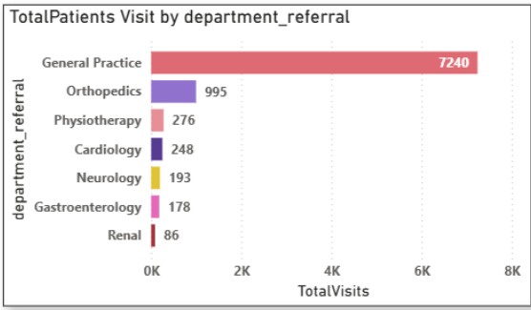
Department Wise Patient Volume
Key Insights:
General Practice receives the highest number of patient visits (7,240) indicating it is the most frequently consulted and high-demand department in the hospital.
Departments like Renal and Gastroenterology record the lowest patient volumes, suggesting either limited service utilization or potential areas for improved awareness and outreach.

Slide 9
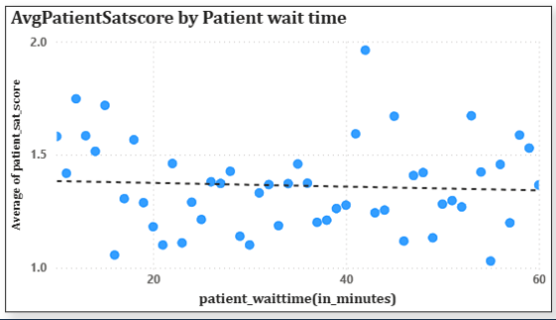
Patient Wait Time vs Satisfaction Analysis
Key Insights:
The trend line shows a slight negative correlation between patient wait time and satisfaction score, indicating that longer waiting periods generally lead to lower patient satisfaction. However, the overall satisfaction scores remain low and scattered, suggesting that factors beyond wait time such as service quality or staff interaction may also influence patient experience

Slide 10
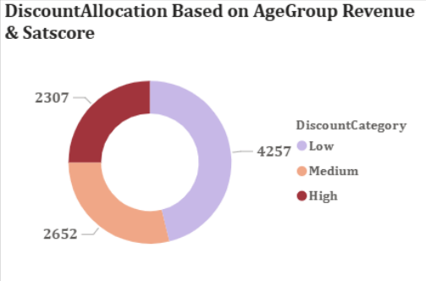
Discount Allocation Analysis
Key Insights:
The discount allocation was primarily determined based on age group and revenue contribution, while average satisfaction score was considered only at a group level to maintain fairness and simplicity. The majority of patients fall under the Low discount category, indicating strongperforming age groups in terms of revenue, whereas High discounts were assigned to lower-revenue or less-engaged groups to encourage better participation

Slide 11
Recommendations
1. Optimize Doctor Allocation Across Departments
Increase the number of doctors in high-revenue and high-demand departments to reduce workload and patient wait times.
Redistribute staff from low-patient-volume departments to improve efficiency and service utilization.
Continuously monitor patient flow trends to plan future hiring and ensure balanced department staffing.

Slide 12
Recommendations
2. Strengthen Patient Feedback and Engagement System
A large portion of missing satisfaction scores (~72%) indicates the need for a more effective and engaging feedback mechanism
Develop a simple and engaging feedback mechanism (like digital kiosks or mobile surveys) to reduce missing satisfaction scores.
Ensure feedback is collected consistently after each visit to capture real-time patient experiences.

Slide 13
Recommendations
3.Refine Discount and Retention Strategies
Allocate discounts primarily based on age group and revenue contribution, ensuring fairness across patient segments.
Offer higher discounts to elderly or low-revenue groups to improve accessibility and engagement.
As satisfaction data improves, incorporate sat_scores into discount logic to reward loyal and satisfied patients effectively

Slide 14
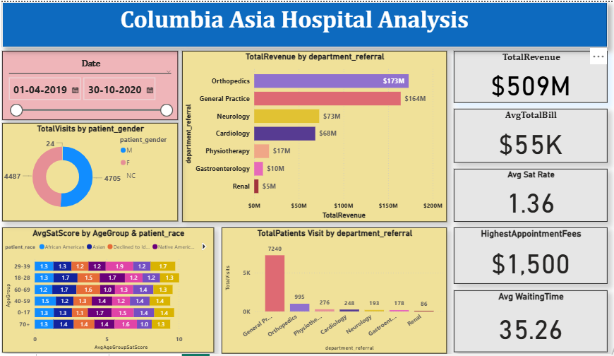
FINAL DASHBOARD(Main Tab)

Slide 15
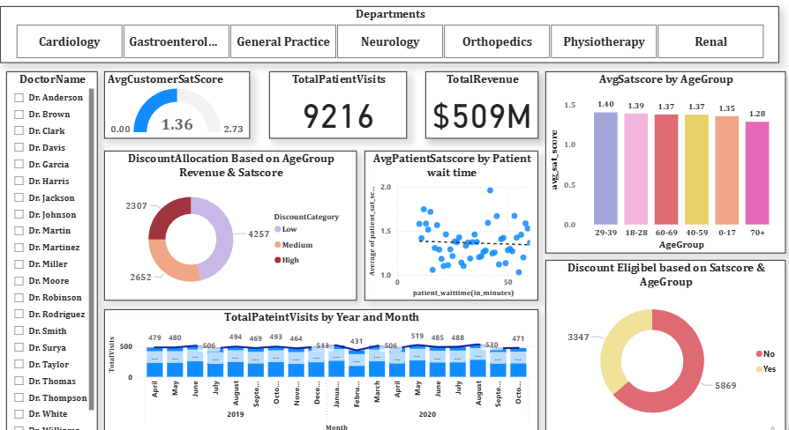
FINAL DASHBOARD(Doctor’s Tab)

Slide 16
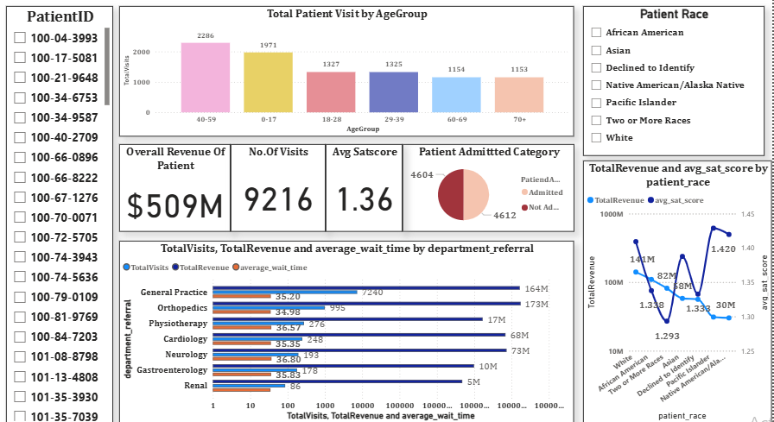
FINAL DASHBOARD(Patient’s Tab)

Slide 17
CONCLUSION
General Practice drives volume, Neurology drives profit
Neurology/Physiotherapy need process redesign
Targeted interventions required for teens/Asian males
Shift A requires 20% more resources
Medium discounts most effective
Quick wins: Teen clinics + neurologist hire
1-min wait reduction → 0.2 satisfaction gain

Slide 18

Thank
You

